Slide 1

Review: Probability Theory (5)
Chris Kiekintveld

Slide 2
Random Variables and Distribution
A random variable X is a numerical outcome of a random experiment
Random variables allow us to operate at a higher level of abstraction than the events
The distribution of a random variable is the collection of possible outcomes along with their probabilities:
Discrete case:
Continuous case:

Slide 3
Random Variable: Example
Let S be the set of all sequences of three rolls of a die. Let X be the sum of the number of dots on the three rolls.
What are the possible values for X?
Pr(X = 5) = ?, Pr(X = 10) = ?

Slide 4
Expectation
A random variable X~Pr(X=x). Then, its expectation is
In an empirical sample, x1, x2,…, xN,
Continuous case:
Expectation of sum of random variables

Slide 5
Expectation: Example
Let S be the set of all sequence of three rolls of a die. Let X be the sum of the number of dots on the three rolls.
What is E(X)?
Let S be the set of all sequence of three rolls of a die. Let X be the product of the number of dots on the three rolls.
What is E(X)?

Slide 6
Variance
The variance of a random variable X is the expectation of (X-E[x])² :

Slide 7
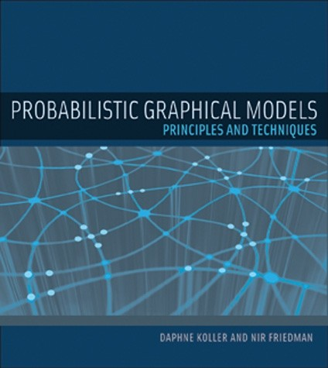
Graphical Models
Exact representation and inference is often intractable
Graphical models (e.g. Bayes nets) use independence to capture the structure of variables

